Slide 1
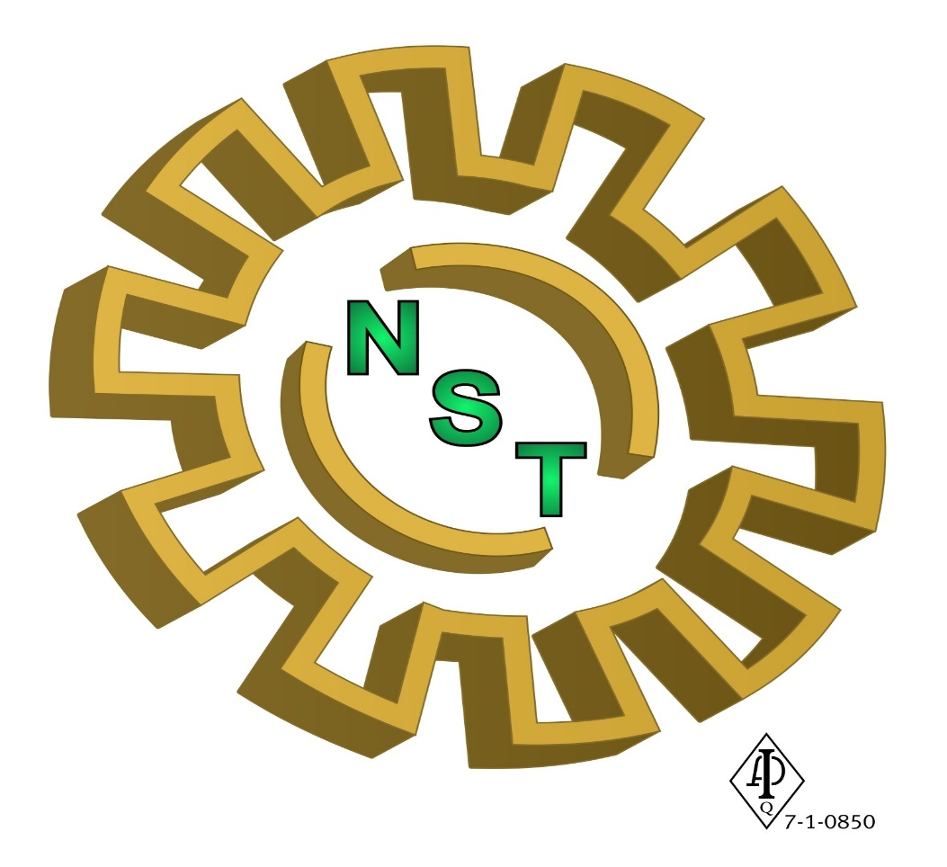
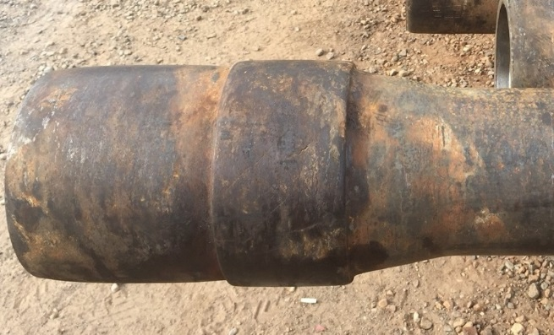
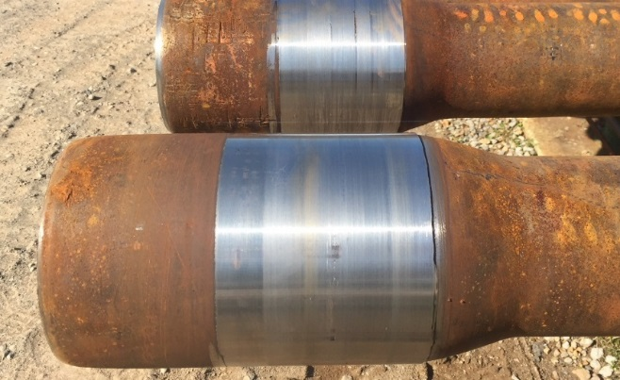
HARD BAND HANGUPS & SOLUTIONS

Slide 2
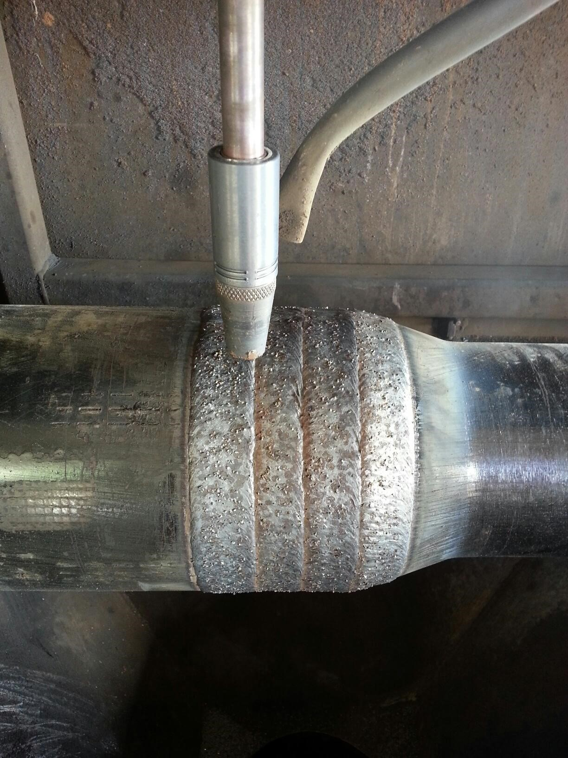
HARD BAND BASICS
A quick overview about hard band is helpful
before jumping into causes and effects. We’ll
start with pictures and show the common
methods and types applied onto tool joints.
Hard band is typically applied in 1” bands…3 of
them typically on top of box with 1” down the
18 degree and 2” on top of the pin with ½” run
down the 35 degree of the pin.

Slide 3
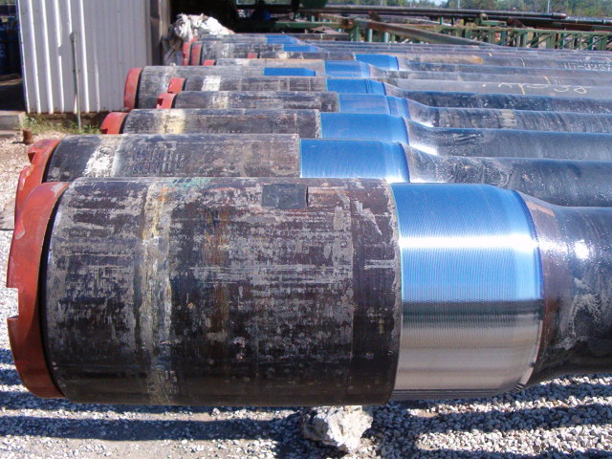
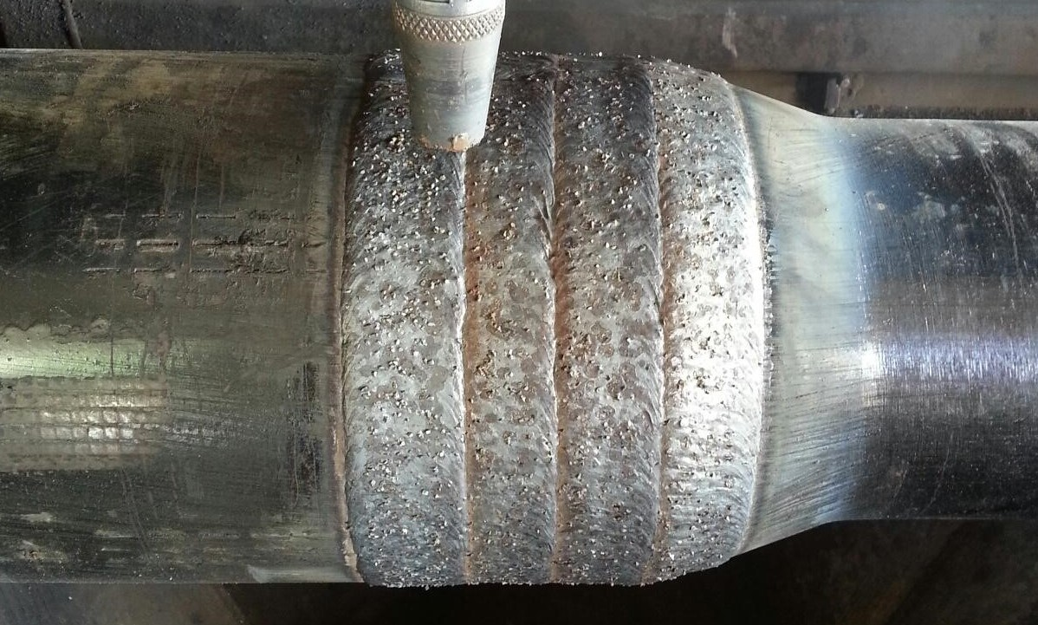
POPULAR TECHNIQUES - 1
Recessing / inlaid flush – Inlaying requires turning 1/8” deep x 2” – 4” long recessed area on the tool joints
NOTE: Hard band is applied only on the box end more often because there’s more room / tong space and it doubles as a protector for the pin tool joint when subject to abrasive drilling operations.

Slide 4
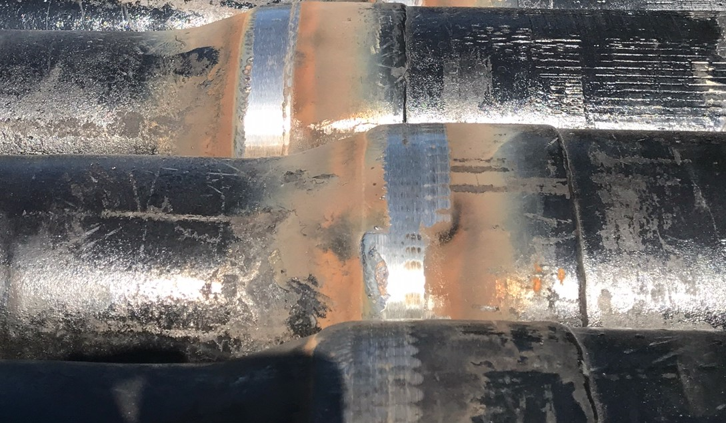
POPULAR TECHNIQUES - 2
Tied in or laid on top - Tungsten can be laid directly on top of “drill steel,” tied in or laid on top of existing tungsten, however; chrome types are more sensitive to laying on top of tungsten and vs/vrs. Sever cracking and / or chipping can occur due to lack of compatibility. Tied in

Slide 5
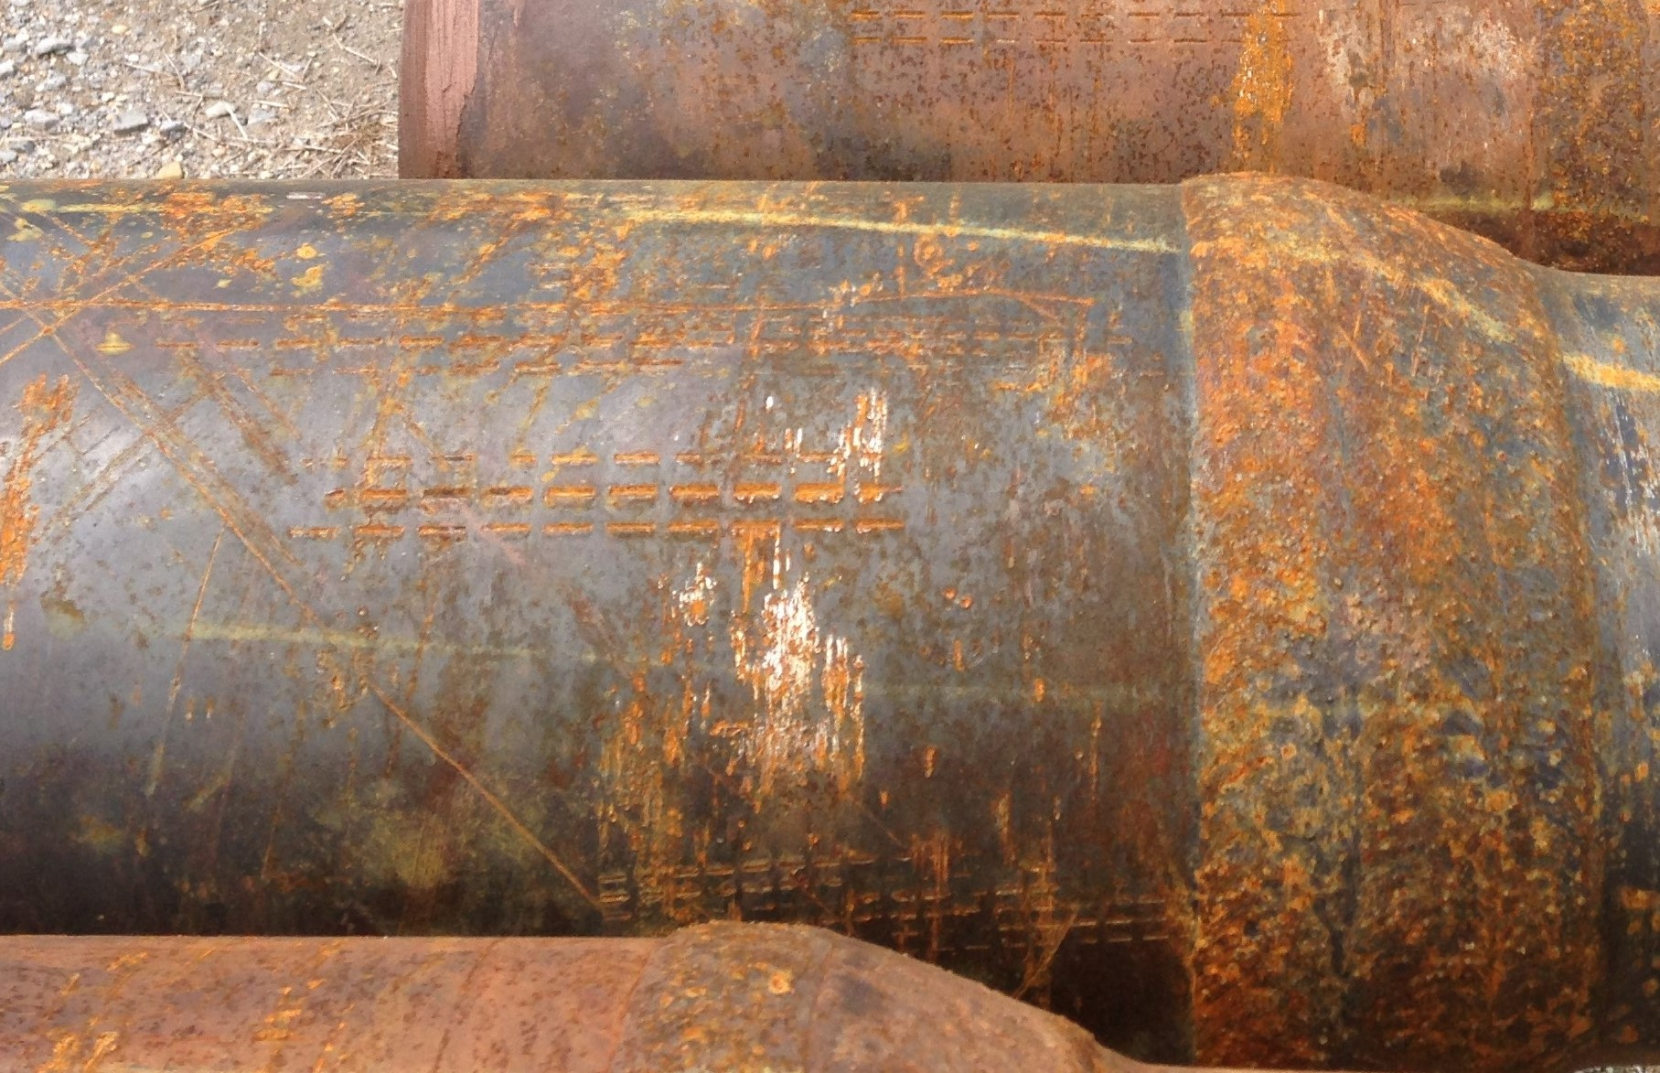
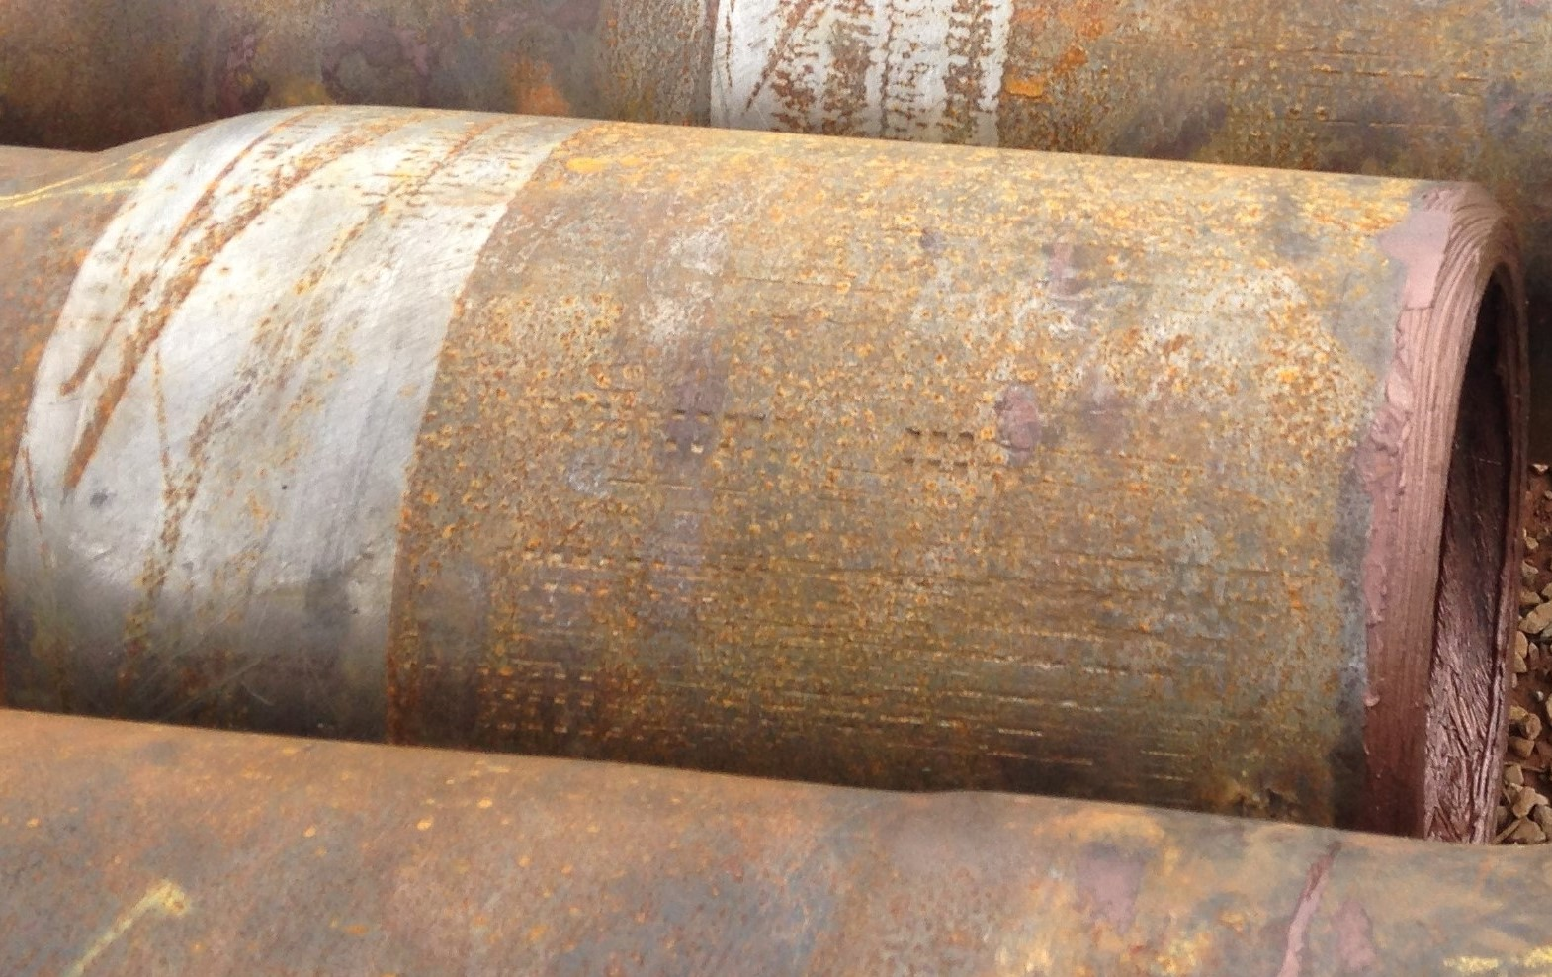
3 common images of hard band
New tungsten appears grey and commonly known as “fine particle tungsten,” which attracts rust when left outdoors while most chrome base hard band is silver in color and stays that way until worn off. Several types of HB boast the term “casing friendly” because of the common abrasive characteristics of fine particle tungsten, however; coarse tungsten will become smooth over time in abrasive/ open-hole drilling conditions.
NEW COARSE TUNGSTEN RUSTY COARSE TUNGSTEN WORN CHROME

Slide 6
How to determine when hard band is present
Occasionally, a contractor will run into the problem of determining if there’s hard band welded on the tool joint. This issue comes up most of the time because there’s so much dirt and clay camouflaging the raw areas coming right out the hole or rust settles on the joints… especially when it’s inlaid flush. In order to determine the presence of hard band, it’s wise to brush the assumed area and look for varying colors in the material. If there’s still no visual difference, going one step further with sulphuric acid might give a better indication. For last resort, If there’s no acid available, a large metal file will work by trying to remove material and comparing how the file “bites” upon the two surfaces in question. The file will slide freely if hard band is present and will bite like it’s supposed to on the softer drill steel. Fortunately, when the hard band is thin enough, the vices will actually bite through and grab the pipe without any issues.

Slide 7
Drill Steel Existing HB
ACID TEST
Sulphuric acid will indicate a slightly lighter test area for drill steel than the hardbanded area

Slide 8
Cause, Effects and Solutions
Outside of HB wear prevention methods, the tool joints are whittled down due to open hole abrasion and high pressure vice clamping. The driller’s ability to bite or handle make and break of connections is reduced due to wear of tool joints including lost length, angle wear, and thinning of material esp. on boxes. In addition to hostile conditions, the vices can actually crush or “egg” the circular shape, and gouge the OD of the boxes. The crushing effect will also cause sever internal thread damage due to abnormal abrasion and pressure applied through the threads with repeated make up/break out operations.

Slide 9
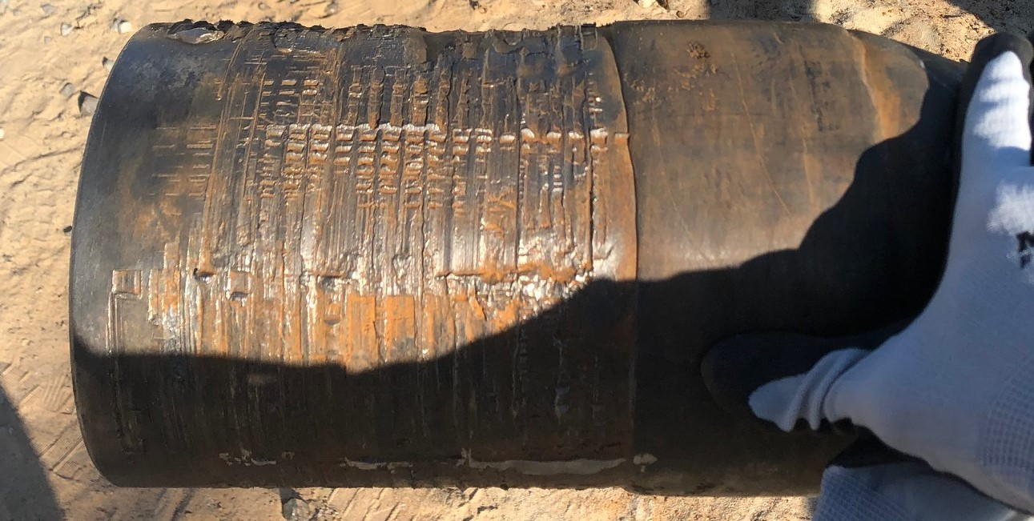
HANGUP 1: VICE / OVERTORQUE DAMAGE

Slide 10
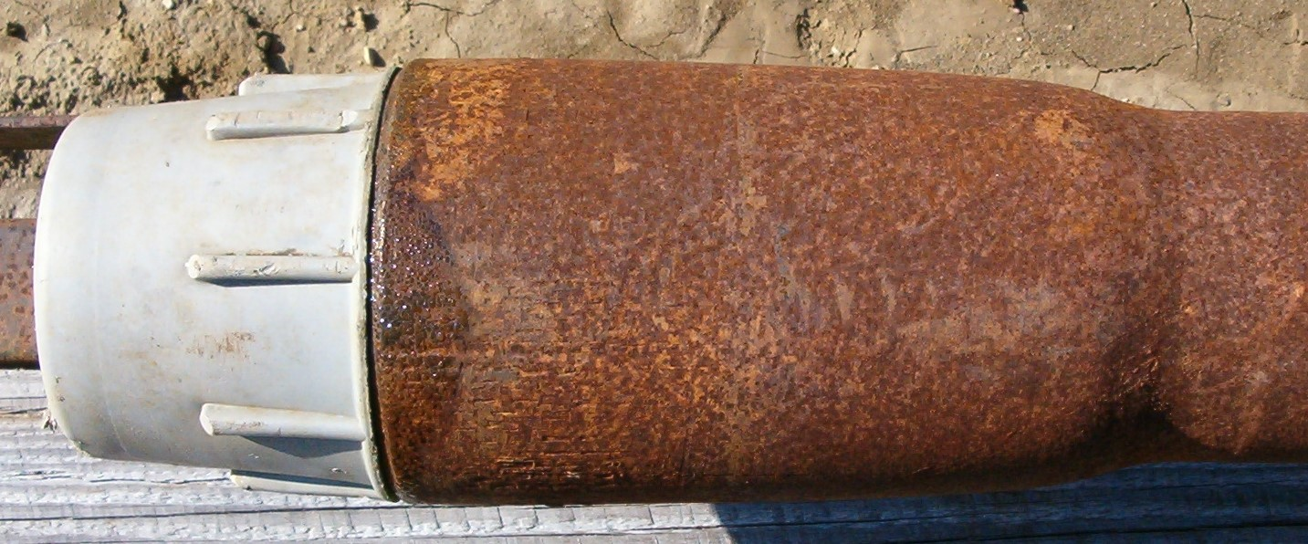
HANGUP 2: OPEN HOLE / ABRASION DAMAGE
The tool joints becoming “coffee cup” cone shaped and tong space will become practically non existent because of the manipulated angle.

Slide 11
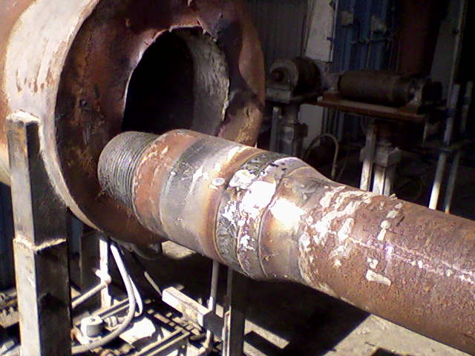
SOLUTION 1 & 2: BUILD UP
Build up can often add another half life but a few factors must be investigated beforehand. First, considering the tube thickness or RBW (remaining body wall of new), there should be at least 90% RBW (depending on new wall thickness) and 80% length / tong space available to justify spending the funds. Secondly, does the pipe need to be re-hardbanded to improve longevity or would it be better to continue building up with drill steel every time the tool joints become thin? Pre-existing Hard band must be removed before building up but both procedures can be done (build up and applying new hardband) can be done simultaneously. BUILD UP BUILD UP WITH HB

Slide 12
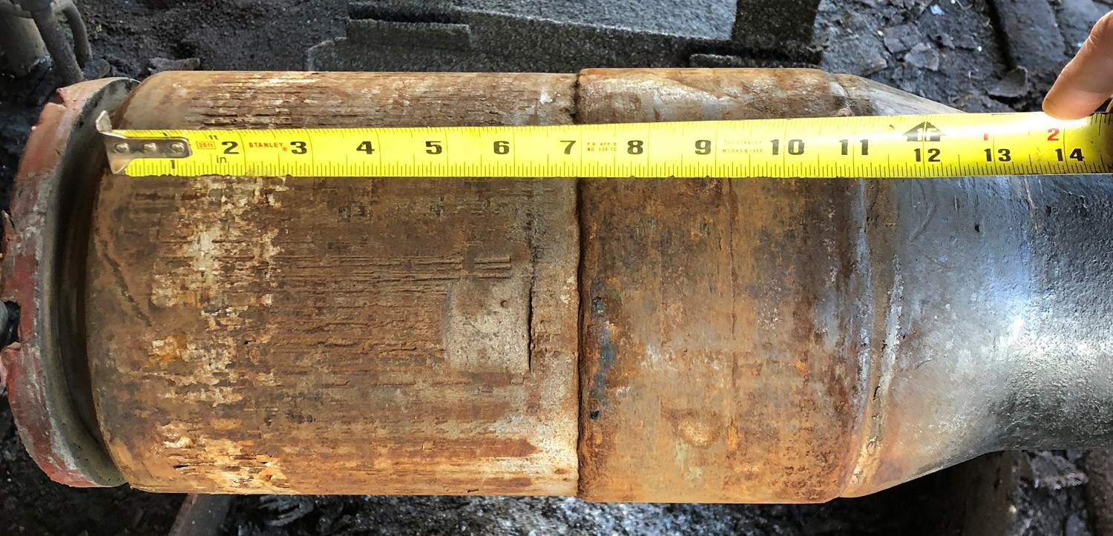
HANGUP 3: UNWANTED HARDBAND
The third step invites asking the question, “is there too much hardband and not enough tong space after a recut of the connection?” The most efficient process used to remove unwanted raised hardband is called arc gouging. The process in the video is done by hand but machines can be programed to do the same for higher quantities.

Slide 13
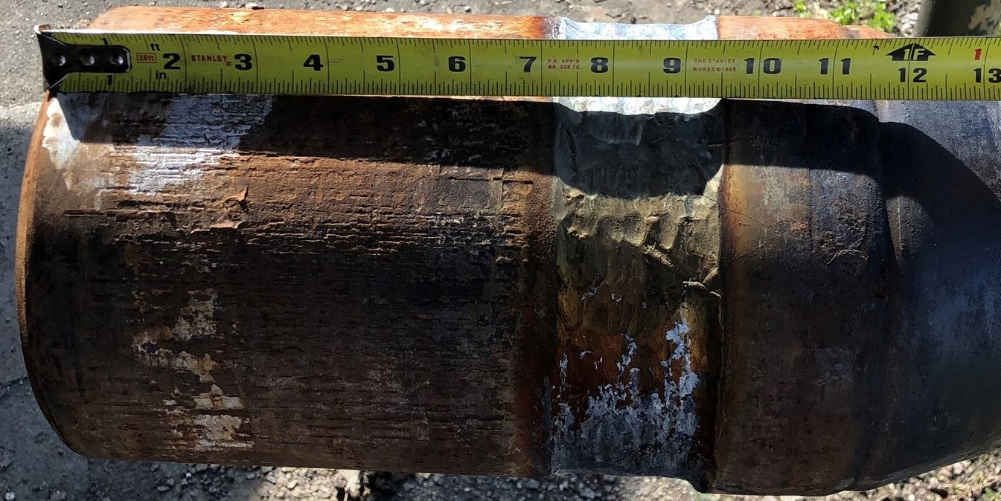
HANGUP 3 (cont’d): UNWANTED HARDBAND
Due to a crater or low spot formed from removing the hardband, a process known as making “butter passes” is used to fill the undercut area with drill steel.
SHORT TONG SPACE ARC GOUGED

Slide 14
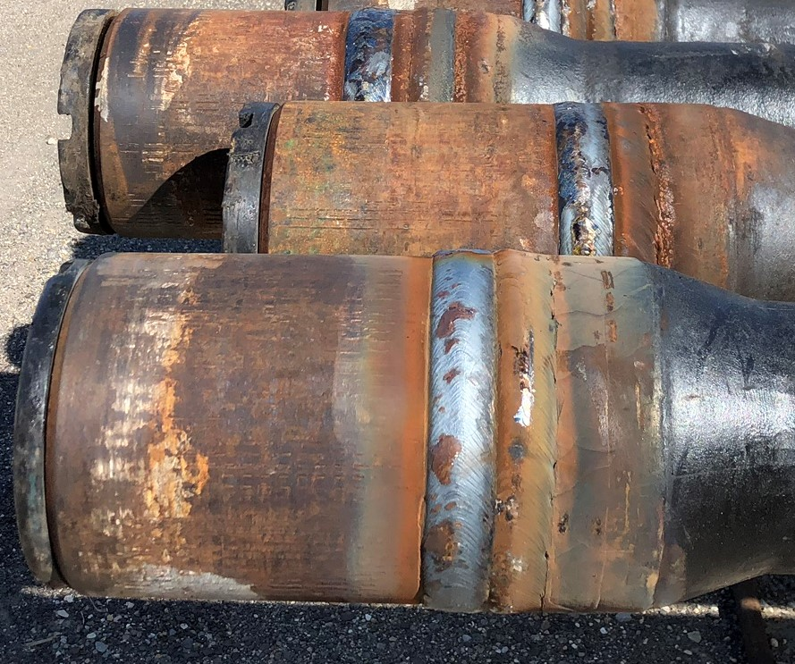
SOLUTION 3: Extra tong space added
HARD BAND REPLACED W/ DRILL STEEL TURNED FLUSH
Drill Steel
Hard Band
Hard Band
Drill Steel
Once drill steel is applied and turned down, the extra tong space is now inline with the existing tool joint and grabbable by the vices

Slide 15
SOLUTION 3 (cont’d): Total HB removed and replaced with turned drill steel
Let HP/NST make more out of less by blowing off the hard band, applying mild steel and turning flush. The short tong area is now converted to pure tong space

